Slide 1
Summer
&
Opening
Training
2025
4.11.2025

Slide 2
Overview
This training will provide Food Service Managers (FSM) with information needed to complete summer orders for the sites summer school programs, RAP, Beyond the Bell (BTB) and HUB receiver sites (if applicable.)
The following summer orders toolkit documents will be reviewed:
Summer Program Start Dates
Summer Orders Calendar
Summer Program Timeline and Ordering Checklist

Slide 3
Summer Program Start Dates
Summer feed operational dates: June 11 - August 13
EEC Sites (Open As Normal) June 11- August 13
RAP Sites June 12 - August 1
BTB/LAB June 17 – July 25
Summer School UTK-8 June 17 -July 25
Summer Term (ST) HS June 17 - July 16
ESY June 17 - July 25 (Stand alone ESY Programs end July 16th)
Enrichment Summer Camps July 21 – August 1
Bridge & Local Design Programs (June 12 - 16) and (August 4 – 8) NSL

Slide 4
Summer Program Main Site
All Summer Sites will login to OneSource using Main Site.
Summer orders will be placed using the Main site name
All sites including; SSO, NSL & EEC
Summer menu plans available in May 2025
On the drop-down, select the Main site

Slide 5
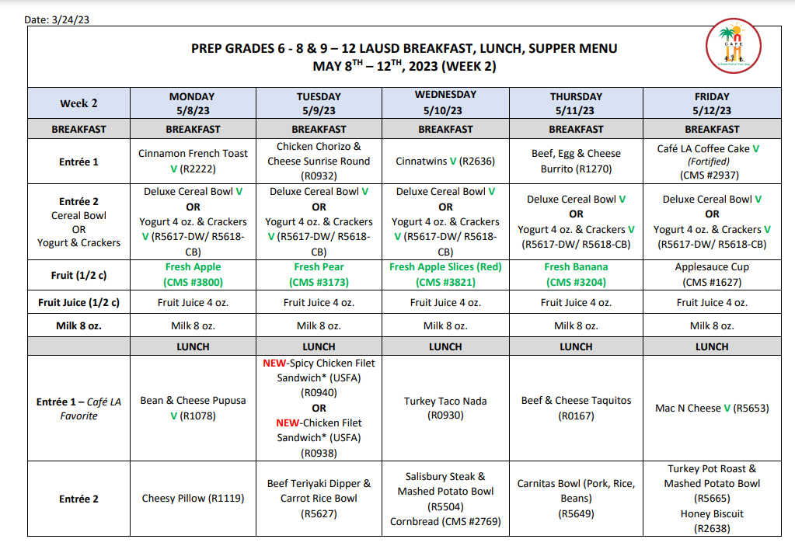
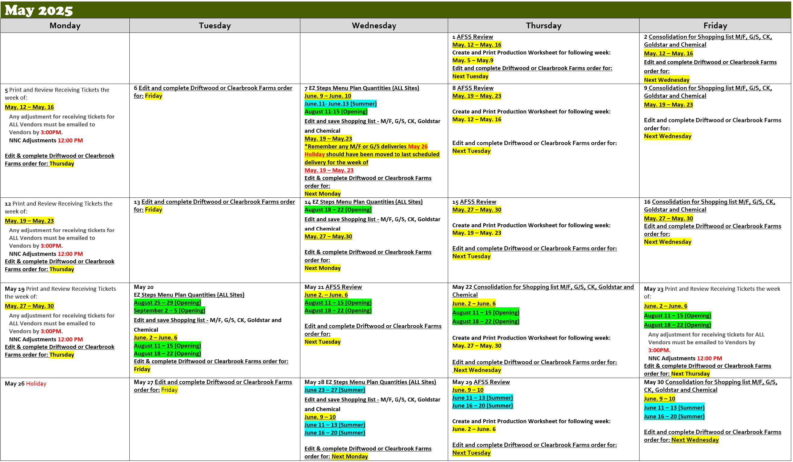
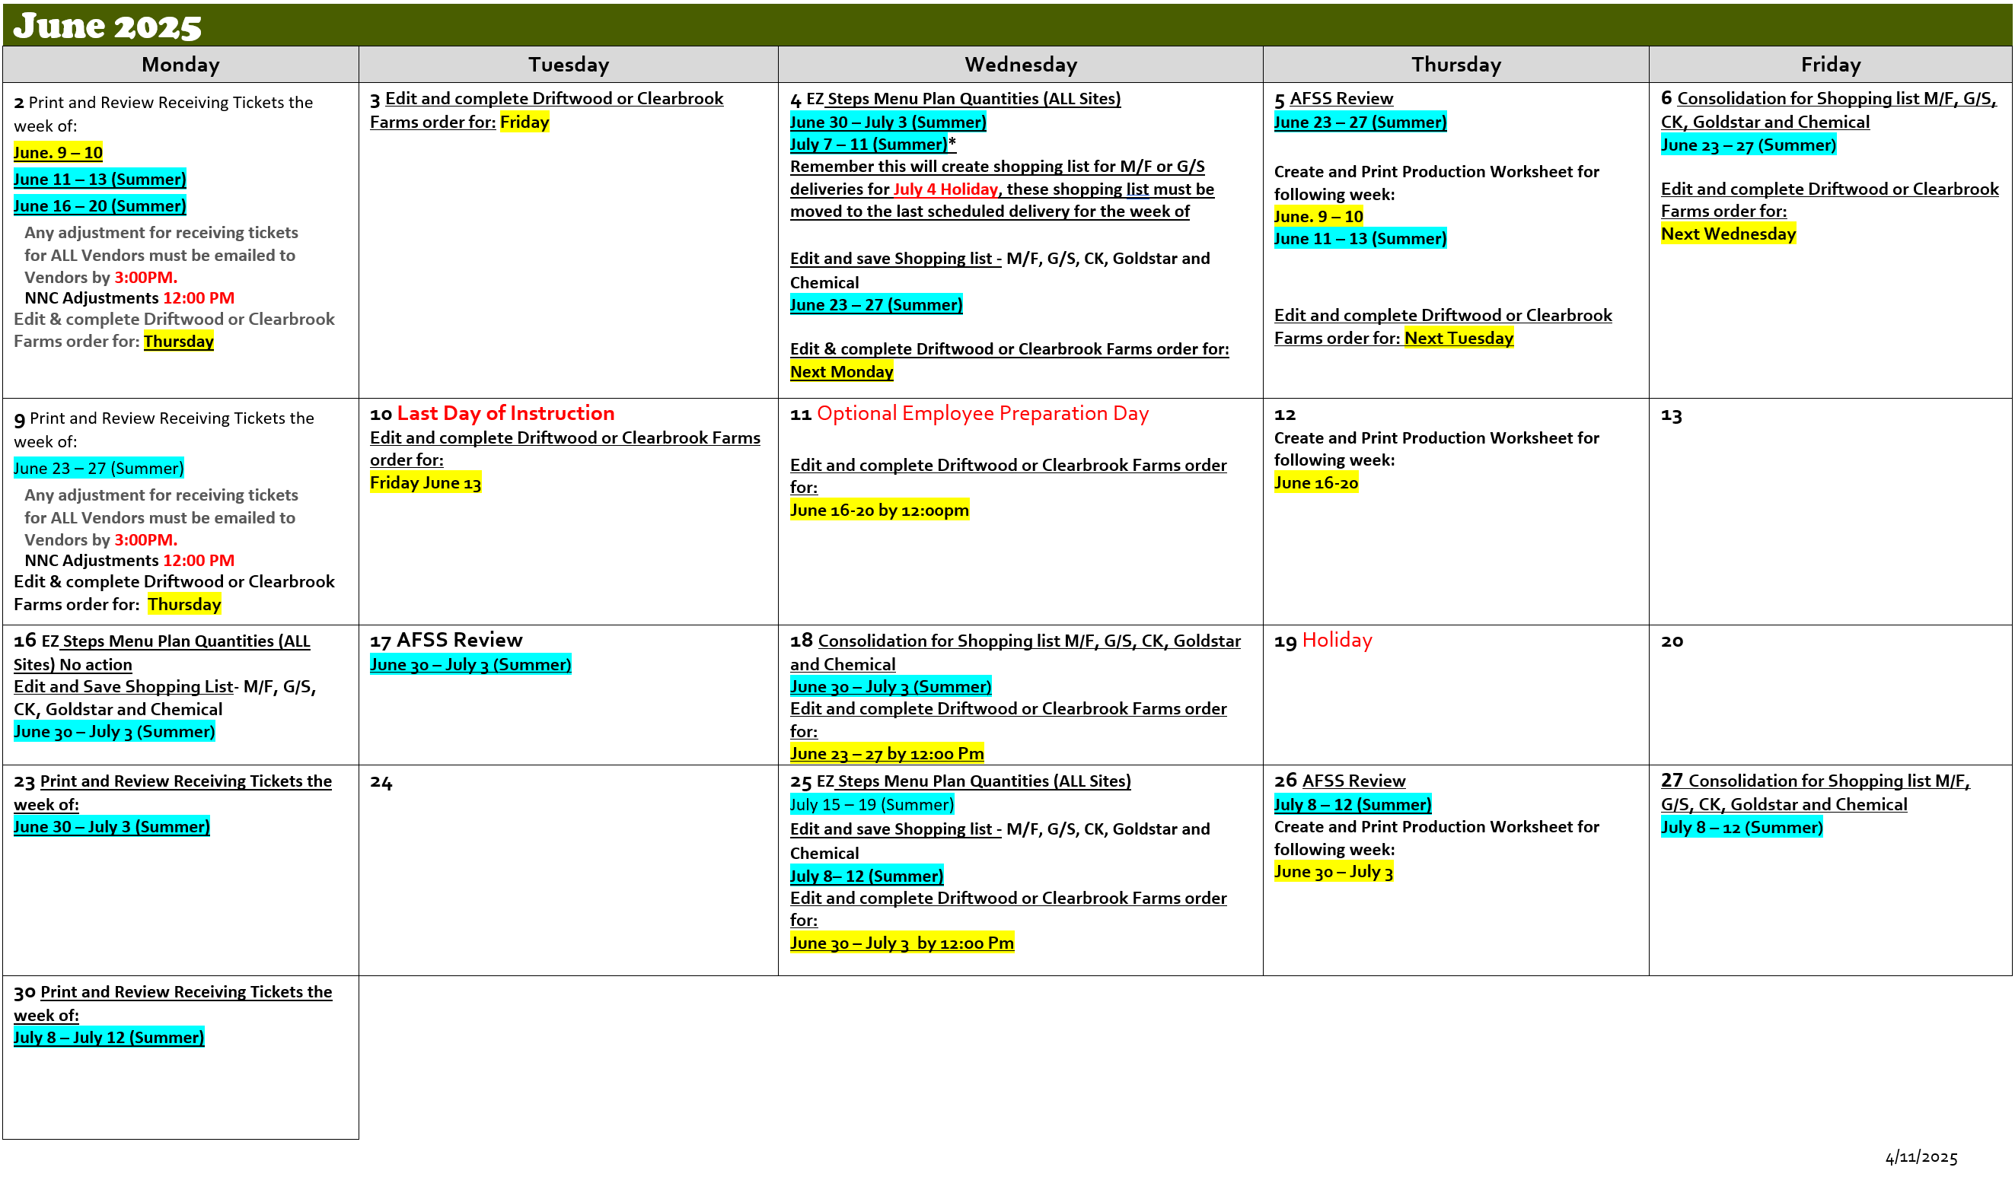
Summer Program Instructions
The on-site Manager doing the ordering must know what programs are being offered at the school and follow the EZ Steps instructions for the programs offered at your site.
If the site has multiple summer programs, follow the procedures (EZ-Steps/shopping list, etc.) for the program that has the earliest start date
Delivery will be the same as the regular school year
Delivery window of 7:00 AM – 1:00 PM
Sites serving RAP, BTB and LAB will include meal orders in E-Z Steps
If a program starts after July 1, contact AFSS for order dates and vendors
Week of June 05, 2023, Through June 09, 2023 RAP, EEC, Summer School TK-8, BTB and LAB | Week of June 12, 2023, Through June 16, 2023 RAP, EEC, Summer School TK-8, BTB, LAB and Summer Term (ST)-HS | Week of June 20, 2023, Through June 23, 2023 RAP, EEC, Summer School TK-8, BTB, LAB Summer Term (ST)-HS | Week of June 26, 2023, Through June 30, 2023 ELOS, BTB and LAB and ESY | Week of July 03, 2023, Through July 07, 2023 ELOS, BTB and LAB and ESY
_____ M/F _____ G/S _____ CK _____ Goldstar _____ Chemical _____ Driftwood _____ Clearbrook | _____ M/F _____ G/S _____ CK _____ Goldstar _____ Chemical _____ Driftwood _____ Clearbrook | _____ M/F _____ G/S _____ CK _____ Goldstar _____ Chemical _____ Driftwood _____ Clearbrook | _____ M/F _____ G/S _____ CK _____ Goldstar _____ Chemical _____ Driftwood _____ Clearbrook | _____ M/F _____ G/S _____ CK _____ Goldstar _____ Chemical _____ Driftwood _____ Clearbrook
Summer Orders 2025

Slide 6
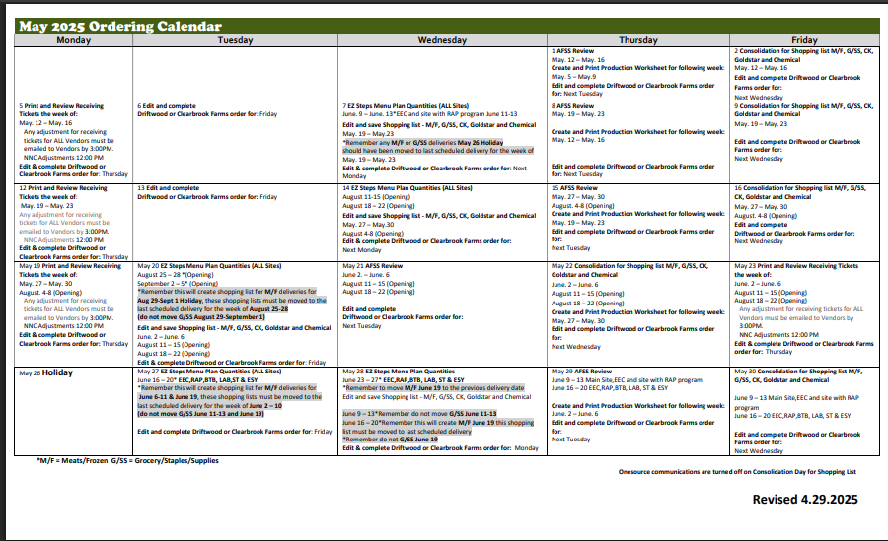
May Ordering Calendar
Week of June 05, 2023, Through June 09, 2023 RAP, EEC, Summer School TK-8, BTB and LAB | Week of June 12, 2023, Through June 16, 2023 RAP, EEC, Summer School TK-8, BTB, LAB and Summer Term (ST)-HS | Week of June 20, 2023, Through June 23, 2023 RAP, EEC, Summer School TK-8, BTB, LAB Summer Term (ST)-HS | Week of June 26, 2023, Through June 30, 2023 ELOS, BTB and LAB and ESY | Week of July 03, 2023, Through July 07, 2023 ELOS, BTB and LAB and ESY
_____ M/F _____ G/S _____ CK _____ Goldstar _____ Chemical _____ Driftwood _____ Clearbrook | _____ M/F _____ G/S _____ CK _____ Goldstar _____ Chemical _____ Driftwood _____ Clearbrook | _____ M/F _____ G/S _____ CK _____ Goldstar _____ Chemical _____ Driftwood _____ Clearbrook | _____ M/F _____ G/S _____ CK _____ Goldstar _____ Chemical _____ Driftwood _____ Clearbrook | _____ M/F _____ G/S _____ CK _____ Goldstar _____ Chemical _____ Driftwood _____ Clearbrook

Slide 7
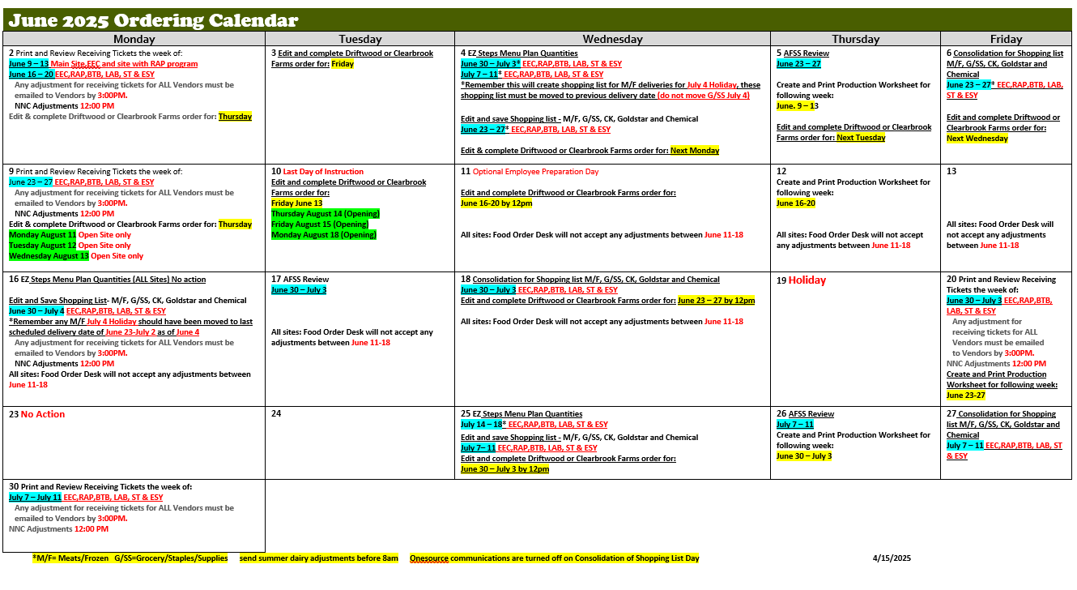
June Ordering Calendar
Week of June 05, 2023, Through June 09, 2023 RAP, EEC, Summer School TK-8, BTB and LAB | Week of June 12, 2023, Through June 16, 2023 RAP, EEC, Summer School TK-8, BTB, LAB and Summer Term (ST)-HS | Week of June 20, 2023, Through June 23, 2023 RAP, EEC, Summer School TK-8, BTB, LAB Summer Term (ST)-HS | Week of June 26, 2023, Through June 30, 2023 ELOS, BTB and LAB and ESY | Week of July 03, 2023, Through July 07, 2023 ELOS, BTB and LAB and ESY
_____ M/F _____ G/S _____ CK _____ Goldstar _____ Chemical _____ Driftwood _____ Clearbrook | _____ M/F _____ G/S _____ CK _____ Goldstar _____ Chemical _____ Driftwood _____ Clearbrook | _____ M/F _____ G/S _____ CK _____ Goldstar _____ Chemical _____ Driftwood _____ Clearbrook | _____ M/F _____ G/S _____ CK _____ Goldstar _____ Chemical _____ Driftwood _____ Clearbrook | _____ M/F _____ G/S _____ CK _____ Goldstar _____ Chemical _____ Driftwood _____ Clearbrook

Slide 8
“Tips” for Fall Opening Orders
Talk to school administration to ask what next school years enrollment will be. Talk to Offsites, Early Education Center and California State Preschool if applicable.
Use current school years enrollment as a baseline when ordering.
If “over order” adjust your future orders following the monthly ordering calendar and contact your AFSS.
(Send email to schools close to you letting them know you have extra
supplies).
If “under order” call neighboring school for extra supplies. Adjust future orders following the monthly ordering calendar.
Week of June 05, 2023, Through June 09, 2023 RAP, EEC, Summer School TK-8, BTB and LAB | Week of June 12, 2023, Through June 16, 2023 RAP, EEC, Summer School TK-8, BTB, LAB and Summer Term (ST)-HS | Week of June 20, 2023, Through June 23, 2023 RAP, EEC, Summer School TK-8, BTB, LAB Summer Term (ST)-HS | Week of June 26, 2023, Through June 30, 2023 ELOS, BTB and LAB and ESY | Week of July 03, 2023, Through July 07, 2023 ELOS, BTB and LAB and ESY
_____ M/F _____ G/S _____ CK _____ Goldstar _____ Chemical _____ Driftwood _____ Clearbrook | _____ M/F _____ G/S _____ CK _____ Goldstar _____ Chemical _____ Driftwood _____ Clearbrook | _____ M/F _____ G/S _____ CK _____ Goldstar _____ Chemical _____ Driftwood _____ Clearbrook | _____ M/F _____ G/S _____ CK _____ Goldstar _____ Chemical _____ Driftwood _____ Clearbrook | _____ M/F _____ G/S _____ CK _____ Goldstar _____ Chemical _____ Driftwood _____ Clearbrook

Slide 9
June 3 closed
Holiday Delivery
FSM's will move only Meat/Frozen orders with a delivery date that falls on a holiday to the previous delivery date.
Juneteenth holiday (all sites):
Move orders with a delivery date of Thursday, June 19 to the previous delivery date.
July 4th holiday (all sites):
Move orders with the delivery dates of Friday, July 4th to the previous delivery date.
CLOSED

Slide 10
Summer E-Z Steps May 2025
1 week of summer orders are due on Wednesday, May 7, 2025
1 week of summer orders are due on Tuesday May 27, 2025
1 week of summer orders are due on Wednesday May 28, 2025
Complete E-Z Steps for summer sites serving EEC, RAP, Summer school TK-8, BTB and LAB.
Due on Wednesday May 7, 2025 - Complete E-Z Steps for summer:
Sites serving EEC, RAP.
_____June 11, 2025 – June 13, 2025 (RAP and EEC)
NOTE: This will create a shopping list for M/F and/or G/S dated June 19th, which is a holiday. This shopping list must be moved to the previous delivery date for that vendor of (June 9th – June 13th, 2025)
Notes:
The due dates for the summer orders are as follows:
Wednesday May 7, Tuesday May 27, and Wednesday May 28.
Complete E-Z Steps for summer sites serving EEC, RAP, Summer school TK-8, Beyond the bell and LA’s Best.
Ez steps for June 11-13 for Summer sites serving EEC and RAP, are DUE on Wednesday May 7th.
-The delivery date for Meats/ Frozen and Goldstar shopping list that are set for June 19, which is a holiday, needs to be adjusted to the previous delivery date of June 9th – June 13th.

Slide 11
Summer E-Z Steps
2. Due on May 27-28, 2025: Complete E-Z Steps for summer:
Sites serving (EEC, RAP, BTB & LAB Sum. Sch. Sum. Term. & ESY)
_____ June 16, 2025 – June 20, 2025, Due May 27
_____ June 23, 2025 – June 27, 2025, Due May 28
NOTE: This will create shopping list for Meat/Frozen delivery for July 4th Holiday, these shopping list must be moved to the last scheduled delivery for vendor

Slide 12
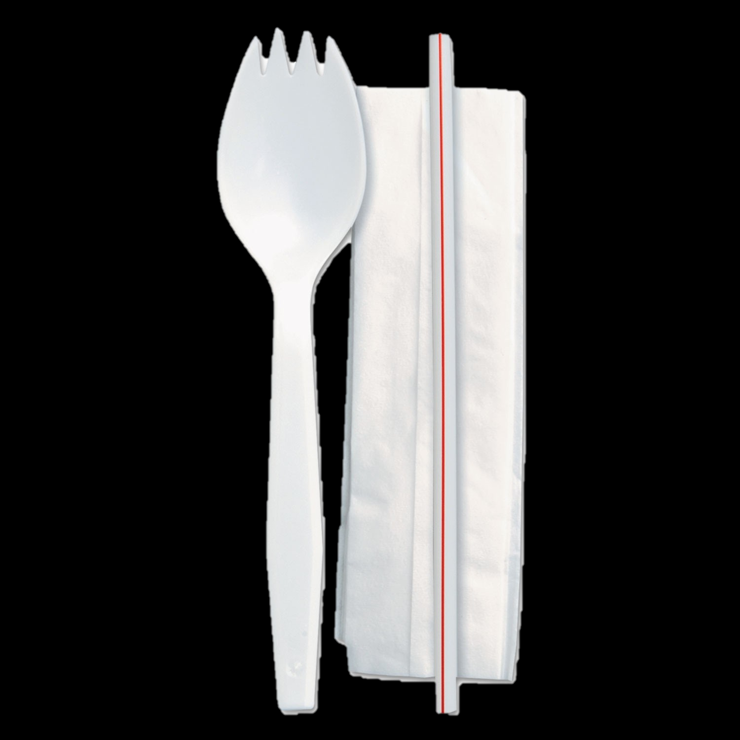
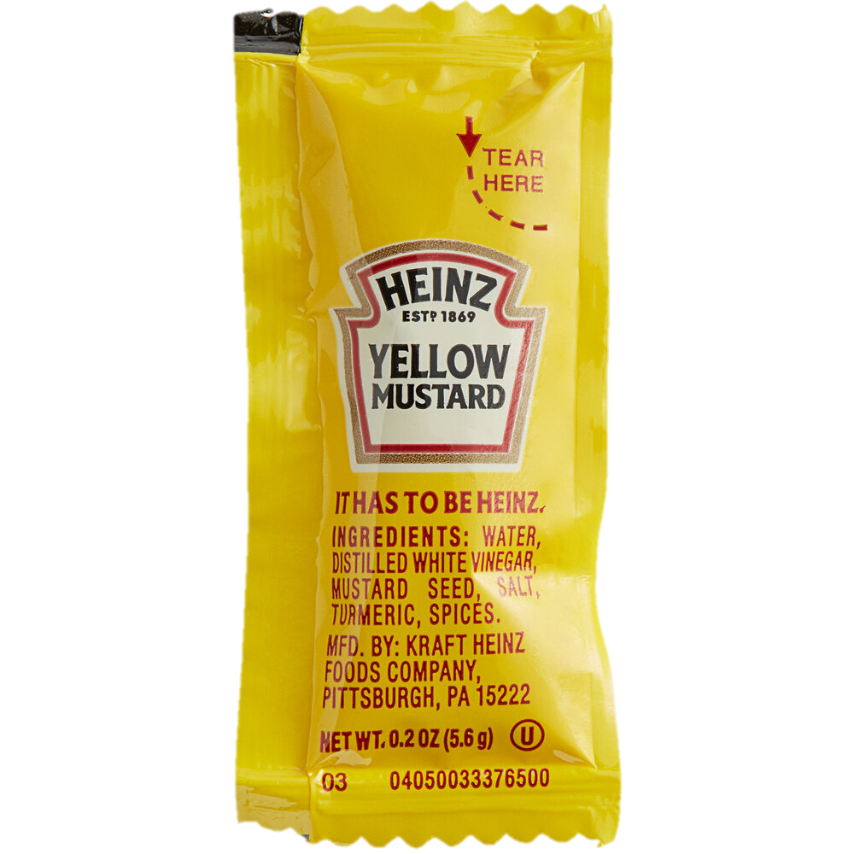
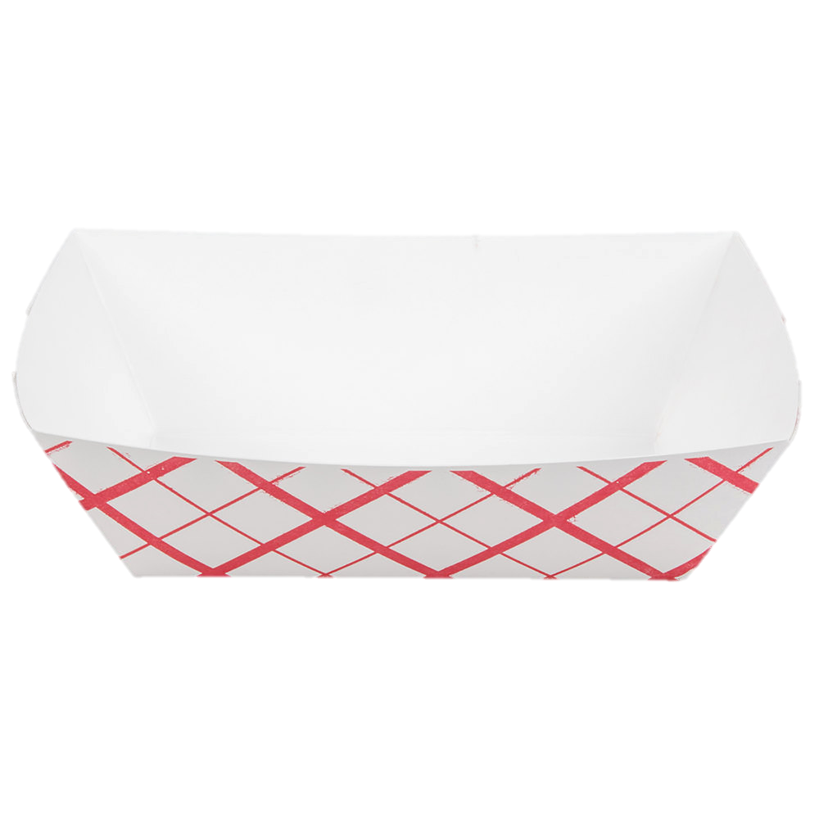
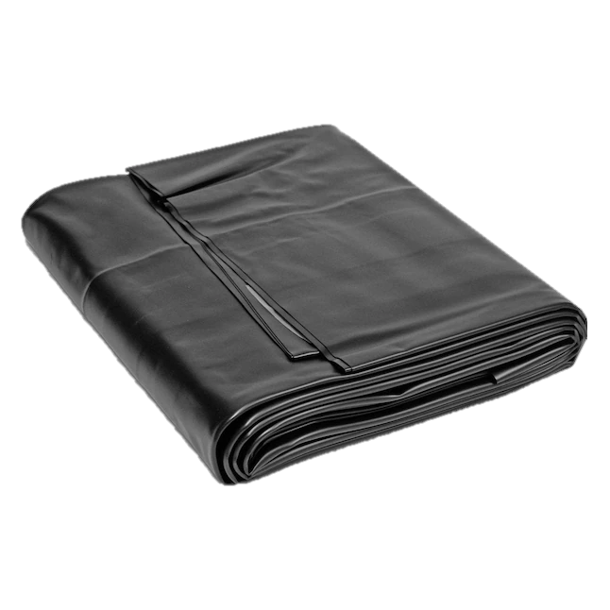
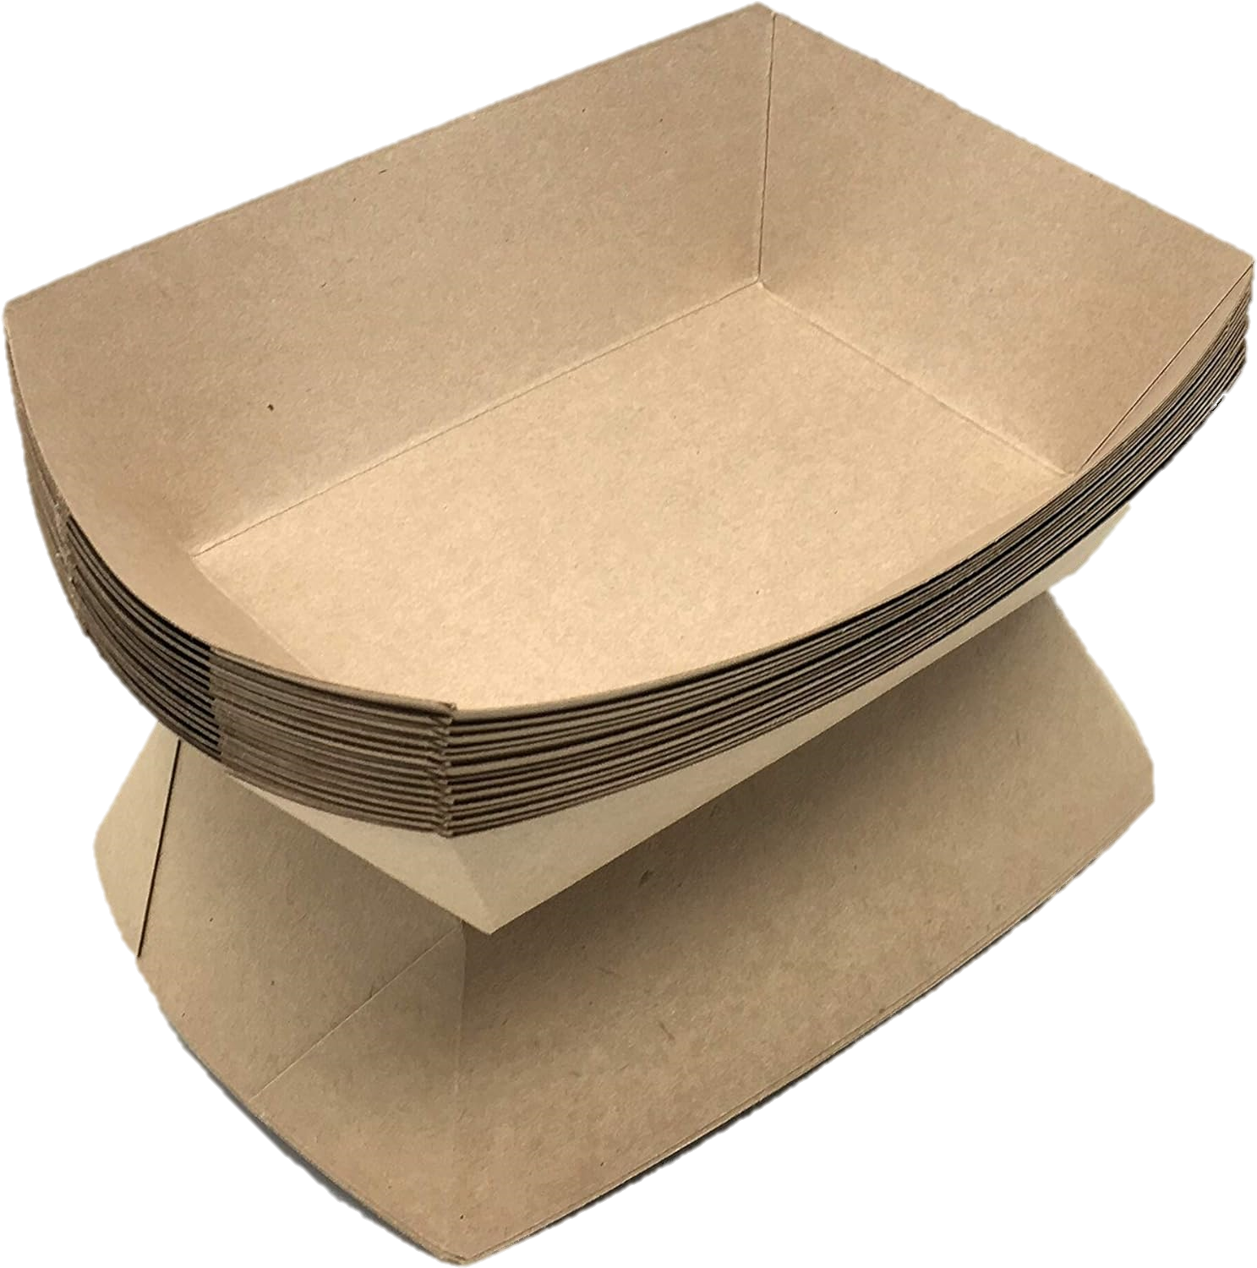
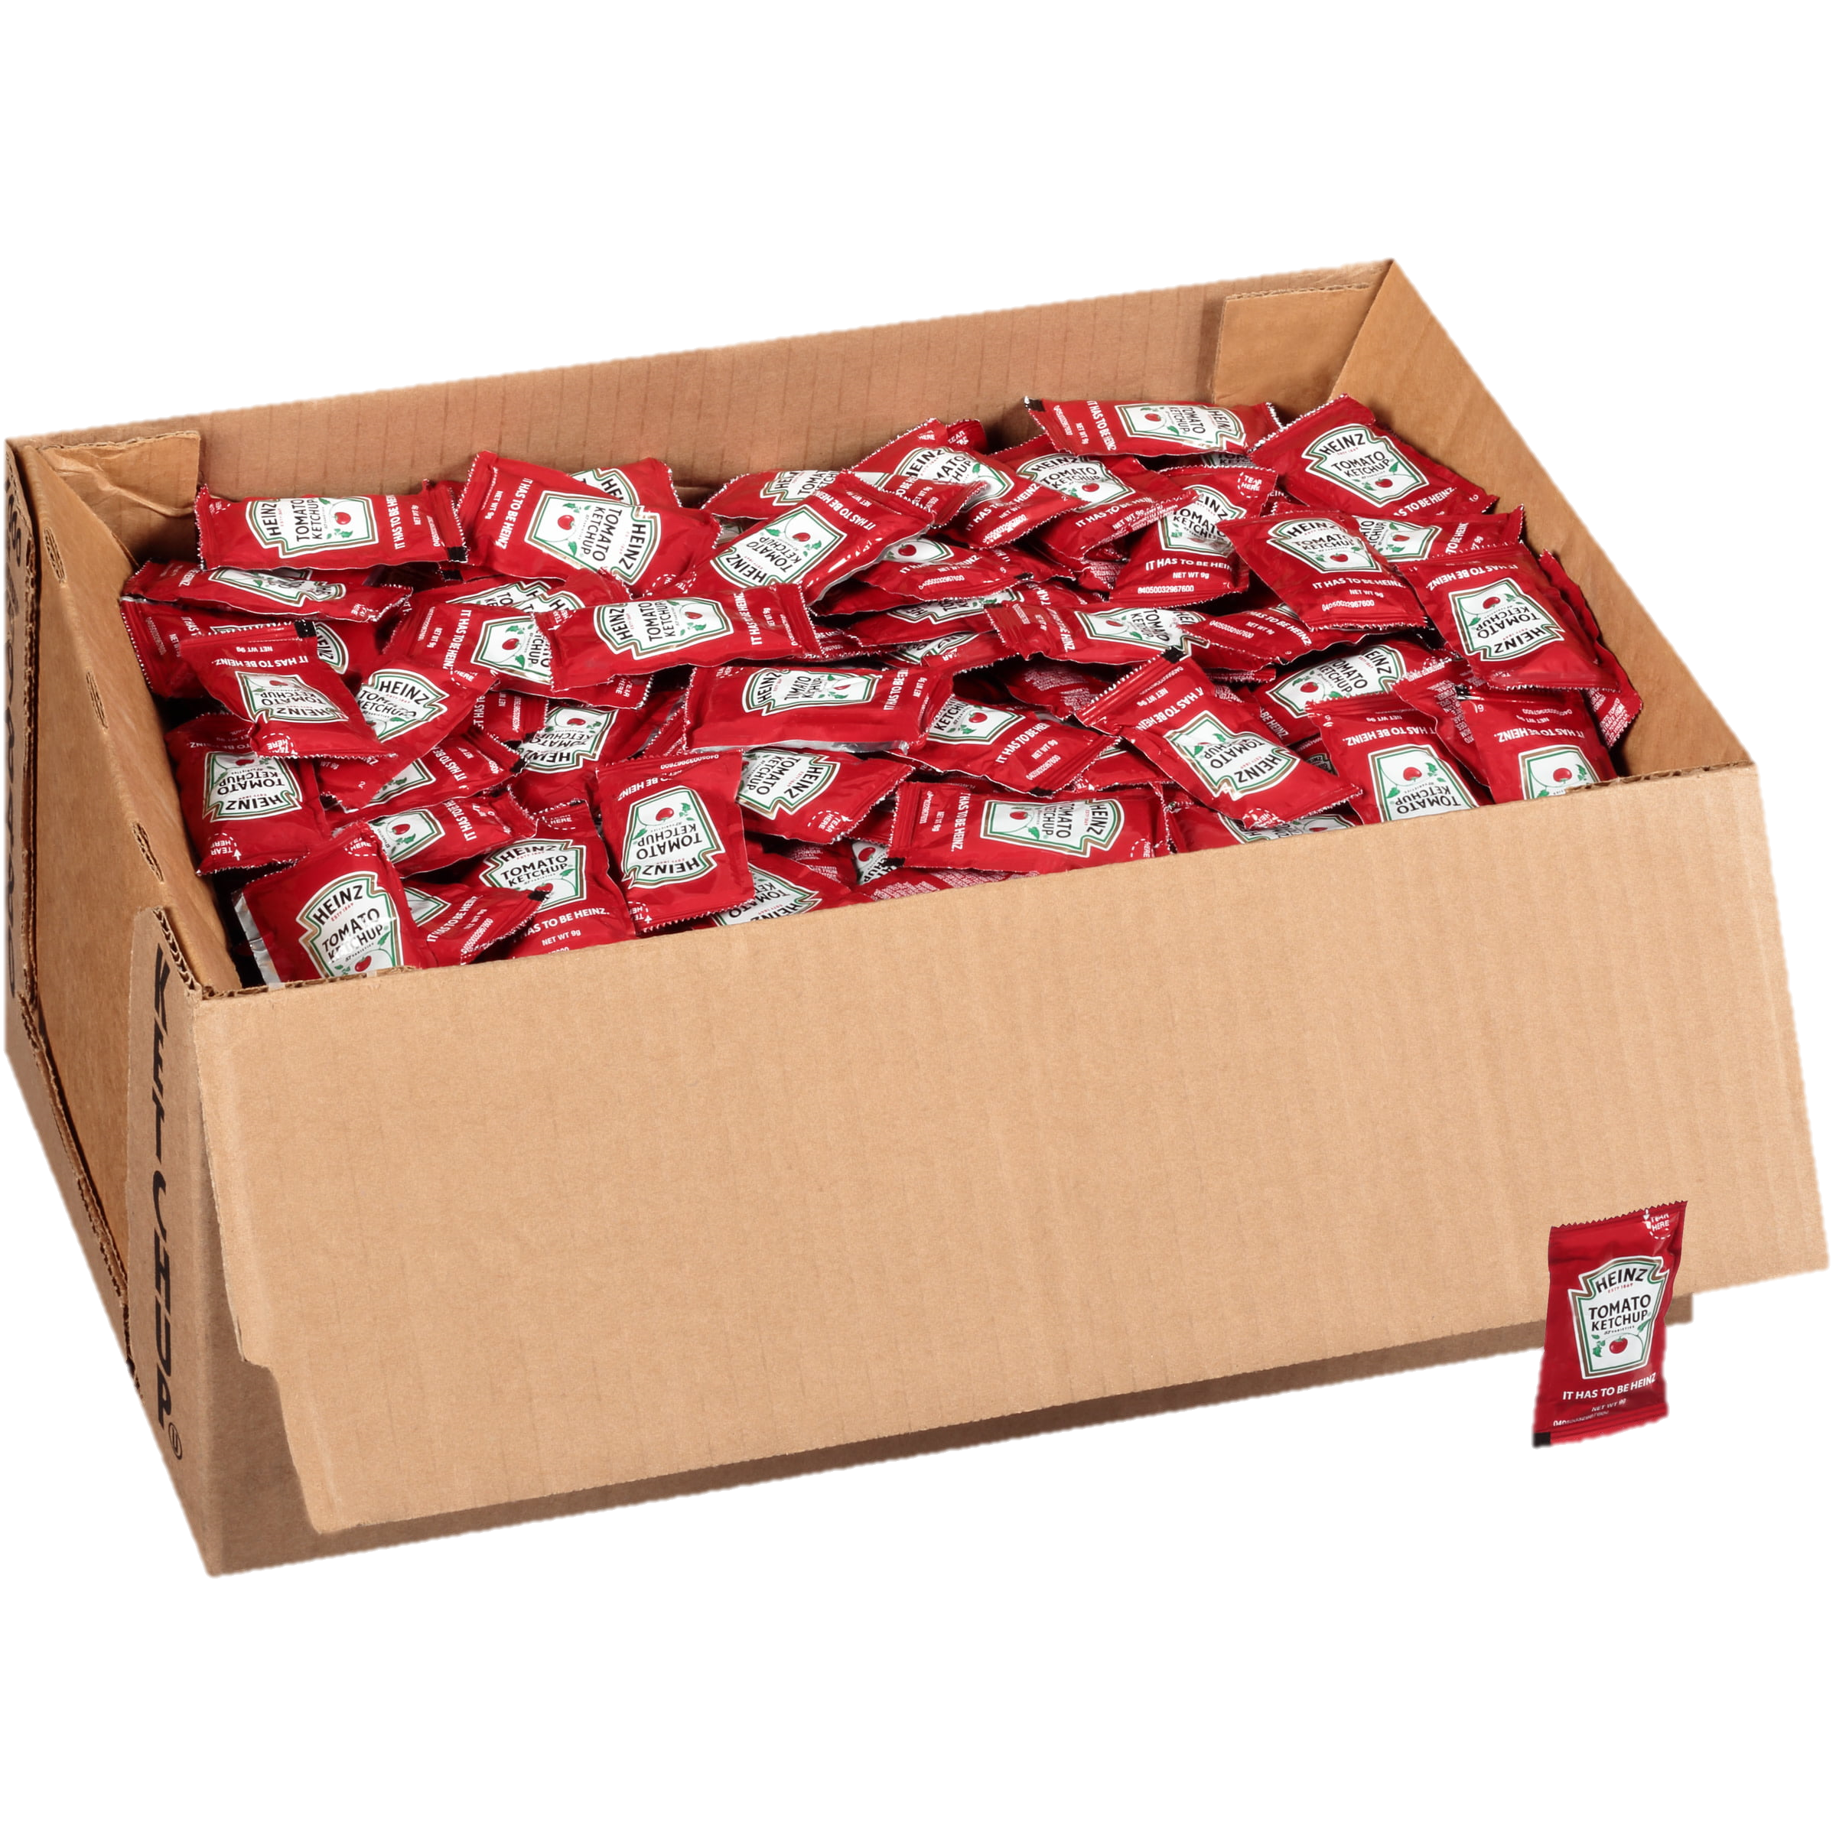
Shopping List
When editing the shopping list, don’t forget to add condiments, paper goods, and supplies to support the summer programs.
EEC
RAP
BTB
LAB
Summer School TK-8
Extended School Year (ESY)
Summer Term HS

Slide 13
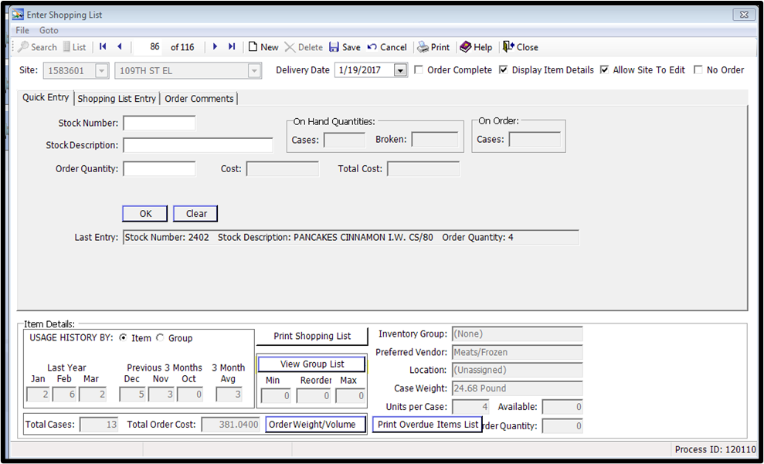
“No Order” Required
When an order is not required, Horizon Onesource has a feature that allows to mark an entire shopping list as “No Order”. You can check the “No Order” box and it will zero out all the items on the shopping list. This will notify Central Office that an order is not needed and is not missing.

Slide 14
Summer Deliveries - Warehouse
All summer sites including EECs’ will be using Main Site to:
Orders will be consolidated under Main Site
Complete EZ-Steps
Review, edit, and save Shopping list (do not mark complete)
Enter receiving tickets
Food Warehouse
Delivery schedule - Delivery will be the same as the regular school year for Meat/Frozen, Grocery/Staples and chemicals.
Delivery window - 7:00 am – 1:00 pm
First summer deliveries are made during the week of
June 2nd- June 10th (The last delivery for the regular year and first
delivery of the summer order will be combined).

Slide 15
Summer Deliveries - Goldstar
All Goldstar deliveries will remain the same as the regular school year.
The delivery window will follow the current night and/or day delivery schedule
Any small orders will need to be consolidated to avoid small delivery drop offs. For example, if you have a two-day weekly delivery, Monday and Wednesday, and your Wednesday delivery is minimal combine with Mondays Delivery.
Be On the look out for Goldstar helpful hints.

Slide 16
Dairy Deliveries - Driftwood
Driftwood orders will be consolidated once a week, every Wednesday.
Driftwood deliveries will be twice a week
Driftwood Delivery will be twice a week according to the delivery schedule that will be provided by Driftwood. Driftwood delivery schedule will be posted on the FSD web page in the “SUMMER” Tab.
FSM's must combine orders as needed to avoid small deliveries.

Slide 17
Dairy Deliveries - Clearbrook
Clearbrook orders will be consolidated once a week, every Wednesday.
Clearbrook Delivery will be twice a week according to the delivery schedule that will be provided by Clearbrook. Clearbrook delivery schedule will be posted on the FSD web page in the “SUMMER” Tab.
FSM's must combine orders as needed to avoid small deliveries.

Slide 18
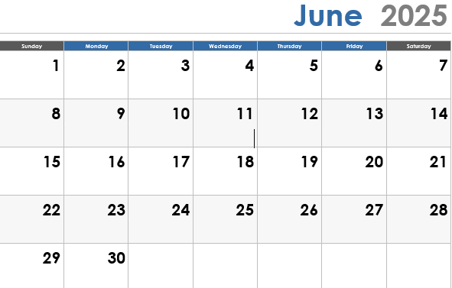
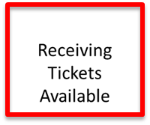
Food Order Desk
Print and Review Tickets June 9-13 & June 16-20

Slide 19
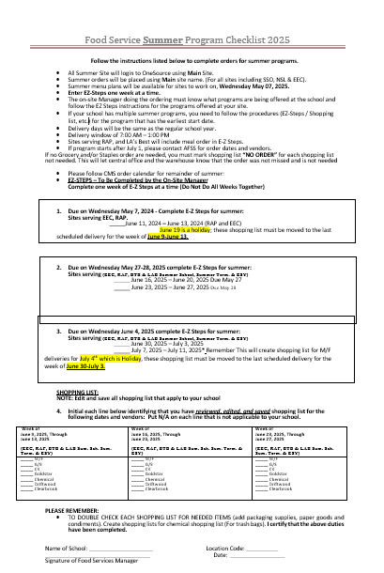
Summer Program Checklist 2025
Follow the instructions listed on the “Food Service Summer Program Checklist 2025”
Remember:
Double-check each G/S shopping list for paper goods, and condiments.
Create a shopping list for chemicals.
Trash bags
Cleaning supplies

Slide 20
Enter EZ-Steps one week at a time.
Do not complete all weeks at once.

Slide 21
Summer Shopping Lists
Edit and save all shopping lists that apply to your school.
Initial each line below identifying that you have reviewed, edited, and saved shopping lists for the following dates and vendors:
Write N/A on each line that is not applicable to your site.
Notes:
For the Summer ordering check list, initial each line once you have reviewed, edited, and saved your shopping list.
Write N/A on the line that does not apply to your site

Slide 22
Summer Program Checklist 2025
After verifying all duties have been completed on the “Summer Program Checklist 2025”, fill out the name of school, location code, manager’s signature, and date.
Email your completed Summer Checklist to your AFSS and file original in your summer folder according to record retention guidelines
LAUSD High School
3230
Great Manager

Slide 23
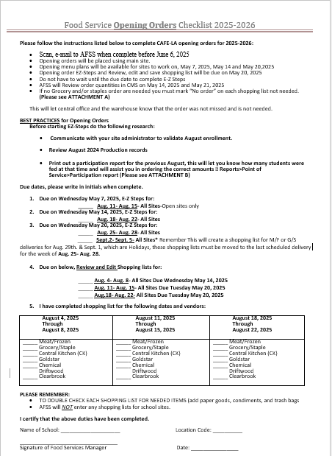
2025-2026
Opening Order
Checklist
Back In
Session
Send Via Email to
AFSS June 6th
4.23.24

Slide 24
Instructions

Slide 25
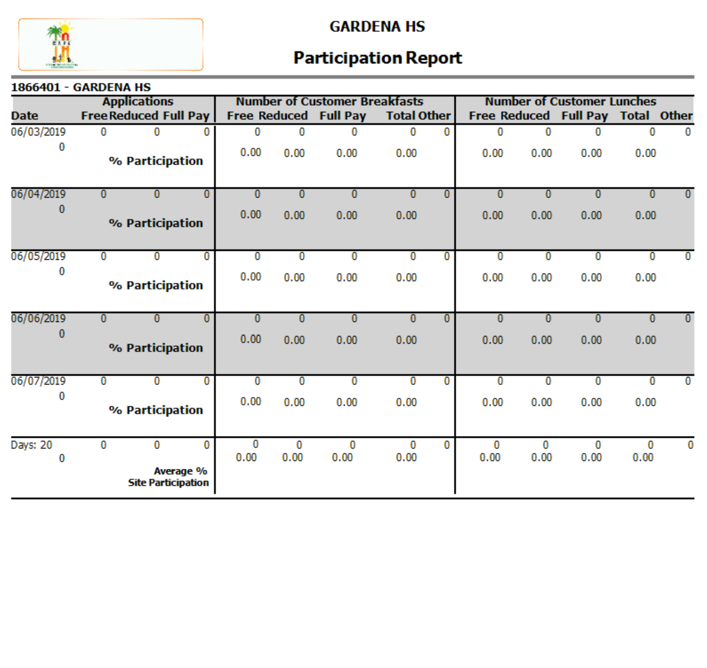
Best Practices

Slide 26
Section 1: EZ Steps Due
CM
CM
CM
CM
CM
EZ-steps are due, for 4 weeks.
Only order one week at a time.

Slide 27
Section 2: Shopping List
CM
CM
CM
Review and Edit shopping lists for 3 weeks.

Slide 28
Section 3: Verify and Initial
AJ
AJ
AJ
AJ
AJ
AJ
AJ
AJ
AJ
AJ
AJ
AJ
AJ
AJ
AJ
AJ
AJ
AJ
AJ
AJ
AJ
AJ
AJ
AJ
AJ
AJ
AJ
AJ

Slide 29
Date & Sign
Site Name
1111
Amazing Manager
Amazing Manager
Amazing Supervisor
Scan and email your opening order checklist to your
Area Food Service Supervisor by June 6, 2025

Slide 30
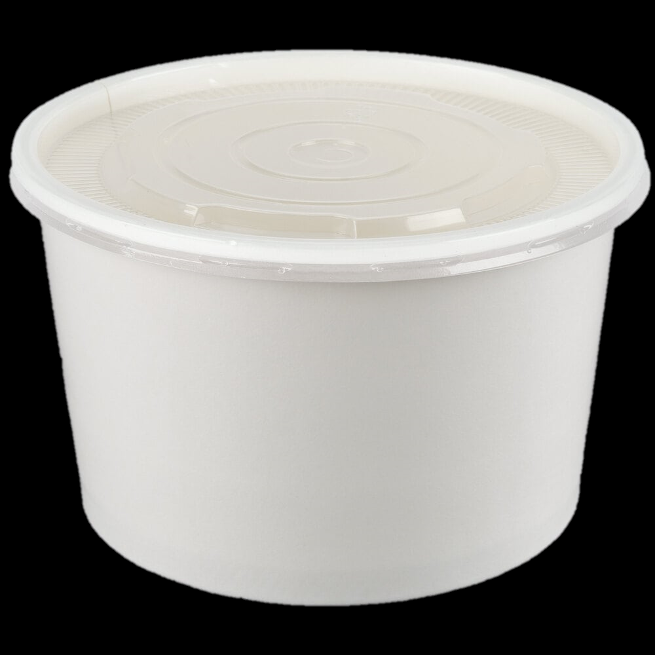
Enter EZ-Steps one week at a time.
Do not complete all weeks at once.
When editing the shopping list, don’t forget to add condiments, paper goods, and supplies for the new school year.
Including for:
EEC
CSPP
Offsites
6oz
8oz
12oz

Slide 31
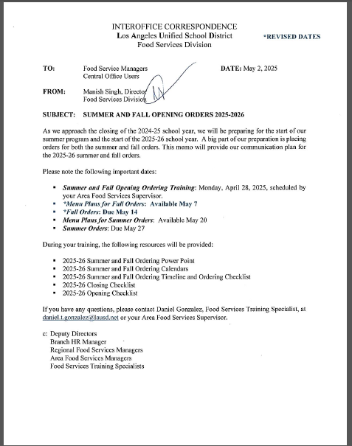
Summer & Opening
Order Memo
Located on Food Service Website under the Summer Folder”

Slide 32
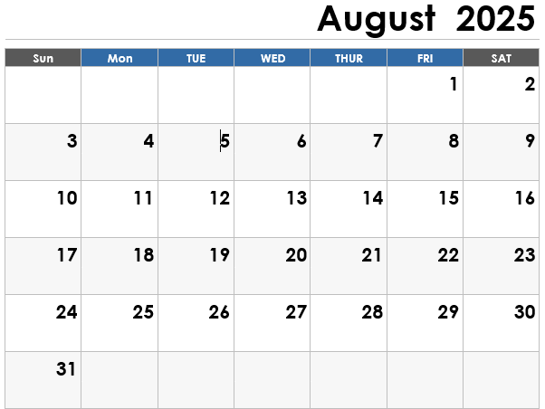
Reminder for Early Start Sites
If your program starts
During July 28-August 1st or August 4th- August 8th
Add items for early start year sites to vendor shopping list.
First order for early start sites should be placed with their Summer Orders.
You need to manually add early start date items to your Summer shopping list.
1st day
of School

Slide 33
Thank you
Any Questions?
Notes:
Thank you everyone! If you have any questions, please raise your hand or enter it into the Chat. Rogelio ? If no question feel free to email the CMS team and we can answer them.

